Slide 1

Social Network Analysis
Huawei Technologies
Presented By:
Alya Al-Naimi Rani Lottey
Mario Godinez Oliver Cabasan
Maggie Hu

Slide 2




SOCIAL MEDIA MARKETING Is Changing The Marketing Landscape
Digital marketing tactic for social media: INFLUENCERS
Marketing
SEO
Website
Social
Media
Digital
Marketing
Traditional
Marketing
Email
Content
PPC
Notes:
Rani
- Social media marketing has become an essential part of any businessʼ digital marketing
What is social media marketing? It’s marketing that uses social networks like Facebook, Instagram, YouTube, and Twitter to build relationships with followers
Why has social media marketing become so important? Social media marketing is all about connecting with an audience or customers and including them in marketing campaigns to build a brand loyalty.
Influencers on social media have a great hold over customers, and they affect the buying and selling decisions of these customers.

Slide 3
Identifying Social Media Influencers Through SNA
SOCIAL NETWORK ANALYSIS (SNA)
An analytical tool that can be used to map and measure social relationships
Characterizes the network structure in terms of nodes (people) and edges (relationships/interactions)
BUSINESS OBJECTIVE
Use SNA to map Huaweiʼs Facebook networks and identify the most important or central individuals in the network.
Central individuals would be influencers that can be engaged for social media marketing
DATASET
Huawei Technologies Co. user-network (directed and labeled) having 1,000 nodes and 250,315 edges
Data collection - web crawler APIʼs used to extract Facebook posts and comments (created May 1, 2018)
Notes:
Rani
Huawei Technologies is a Chinese multinational networking, telecommunications and services company; it is the largest telecommunications equipment manufacturer in the world.
Like other multinationals Huawei uses both digital and traditional marketing methods.
They use social media marketing and social network analysis tools and techniques to increase market share, drive engagements and increase revenue.
Data - only positive reviews extracted from posts after data pre-processing, 1000 rows x 1000 columns
Alethia framework was also completed

Slide 4
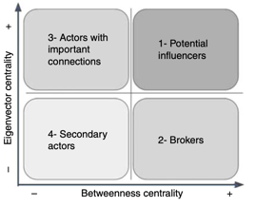
METHODOLOGY
Determining Key SNA METRICS To Find Influencers
Degree Centrality - number of connections
Closeness Centrality - closeness to the entire network
Between Centrality - bridges nodes
Eigenvector Centrality - connectedness to well connected nodes
Pagerank – connectedness to well connected nodes with emphasis on in-degree
Tools:
Gephi – evaluation tool
Python Networkx – evaluation tool
Github – main repository
SigmaJS Explorer (Gephi Plug-in) – tool for the deployment
Notes:
Oliver
- One of many methodologies in the industry and based on XXX
We used a combination of both Gephi and Python tools
Degree Centrality: most direct connections or most active individuals in the network.
Closeness Centrality: transfer of data speed is greatly facilitated by the closeness of the individuals in the network

Slide 5
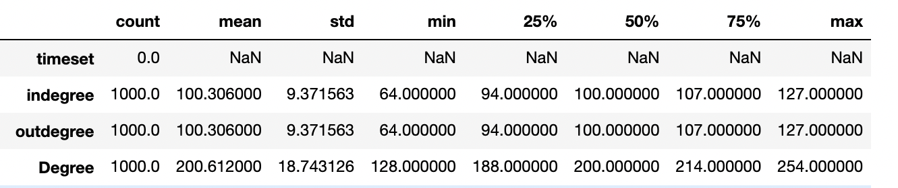
DATA UNDERSTANDING
Generating Different Datasets For Exploration
1. Full Facebook dataset 100% nodes & edges
2. Top 25% Facebook dataset (most connected nodes)
Both datasets were imported to Python for cleaning and data exploration
Gephi
Python
Top 25% Based on Number of Degrees
Notes:
Oliver
- Generated the network and network metrics in Gephi and then exported that as a cvs file into python for further cleaning, exploration and analysis
- Top 25% dataset:
Load the full dataset into Python and determine the number of degrees needed to filter only the 75th percentile (top 25%) of the original list. Based on the describe function in python, the top 25% should be within the 214 degrees (see table below)
Use the number of degrees (214) in the degree range filter of Gephi to extract the top 25%.
- Heatmap of the metrics were created which showed high correlation between the 5 metrics noted in the methodology

Slide 6
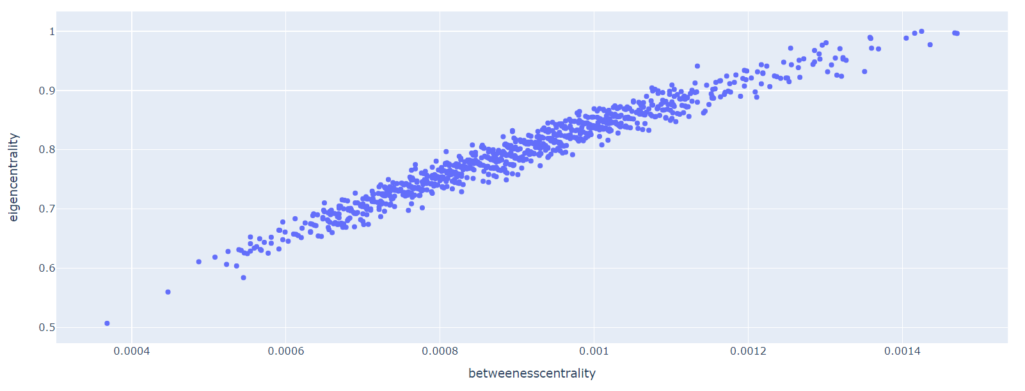
Key Metrics Indicate Potential Influencers Within Q1 Matrix
Eigenvector Centrality vs Betweenness Centrality
Influencers
Pageranks vs Betweenness Centrality scatterplot is a similar plot
Notes:
Alya
-To note is that these metrics provide an initial list of potential influencers, and this list can be improved upon by including the other metrics previously listed i.e. Degree Centrality, Closeness Centraility and Pagerank.
Interactive visualization – can hover over point to get detailed information about data associated to that point

Slide 7
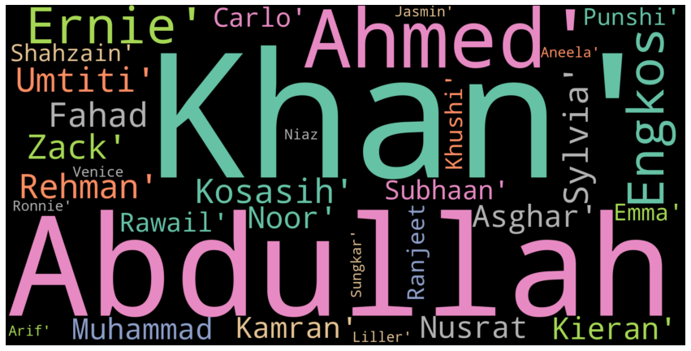
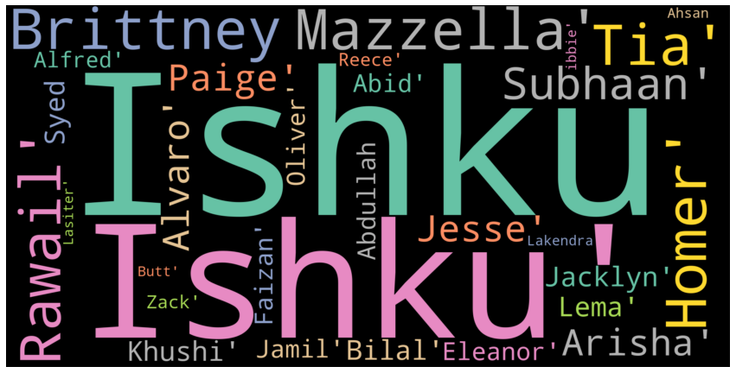
WORDCLOUD Summarizes Top Influencers Across Five Metrics
FULL DATASET
TOP 25% DATASET
Five Metrics
Degree Centrality
Closeness Centrality
Between Centrality
Eigenvector Centrality
Pagerank
Notes:
Alya
WordClouds show different members as the most important.
This of interest since how the dataset is chosen can greatly affect who would be considered as members of interest i.e. influencers.

Slide 8
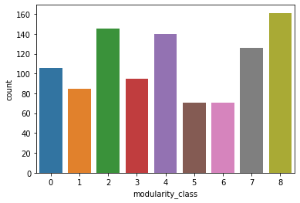
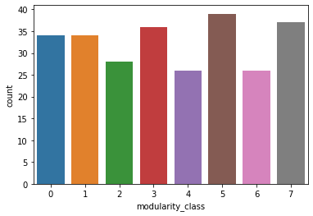
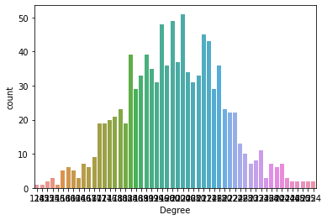
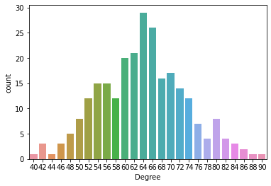
DATA MODELLING Validates Network Communities
Distribution of Nodes By Communities (9)
Full Dataset
Top 25% Dataset
Distribution of Nodes By Degree Value
Full Dataset
Top 25% Dataset
Notes:
Alya
9 distinct communities – comes from the modularity algorithm in Gephi (using the default parameters)
Other metrics were also computed using Gephi
The full dataset shows 3-4 communities which have a higher count of nodes.
The distribution of the top 25% dataset is much more even than the full network dataset.
- In both cases the distributions have a normal bell curve which indicates further fitting or filtering is not required.

Slide 9



Gephi Deploys Web App Directly From Github
WEB APPLICATION TOOLS
Gephi: an open-source software for visualizing and analyzing large networks.
SigmaJS Exporter: Gephi plug-in which exports Gephi graph, creates code and html page for online publishing.
Github Pages: hosts the files for the deployment of Gephi interactive graph managed in our Github repository.
Other Gephi Third-Party Plug-In: tools needed to help publish Gephi online i.e. Multigravity Force Atlas 2, Circle Pack, Label Adjust
WEB APPLICATION DELOYMENT & PRODUCTION
Full Network Dataset: https://3toneles.github.io/networkF/
Top 25% Dataset: https://3toneles.github.io/networkC214/
Notes:
Mario

Slide 10
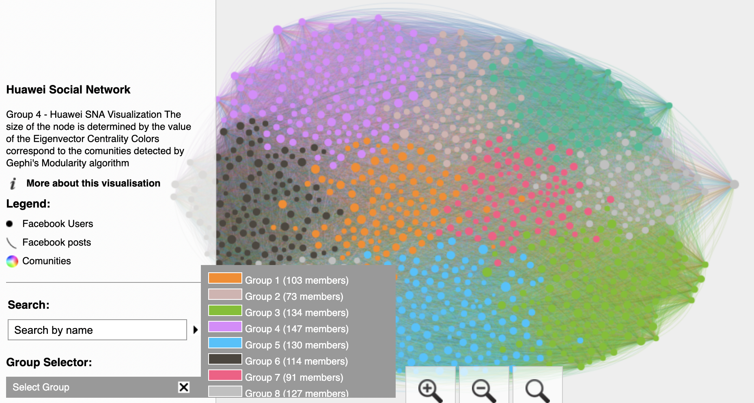
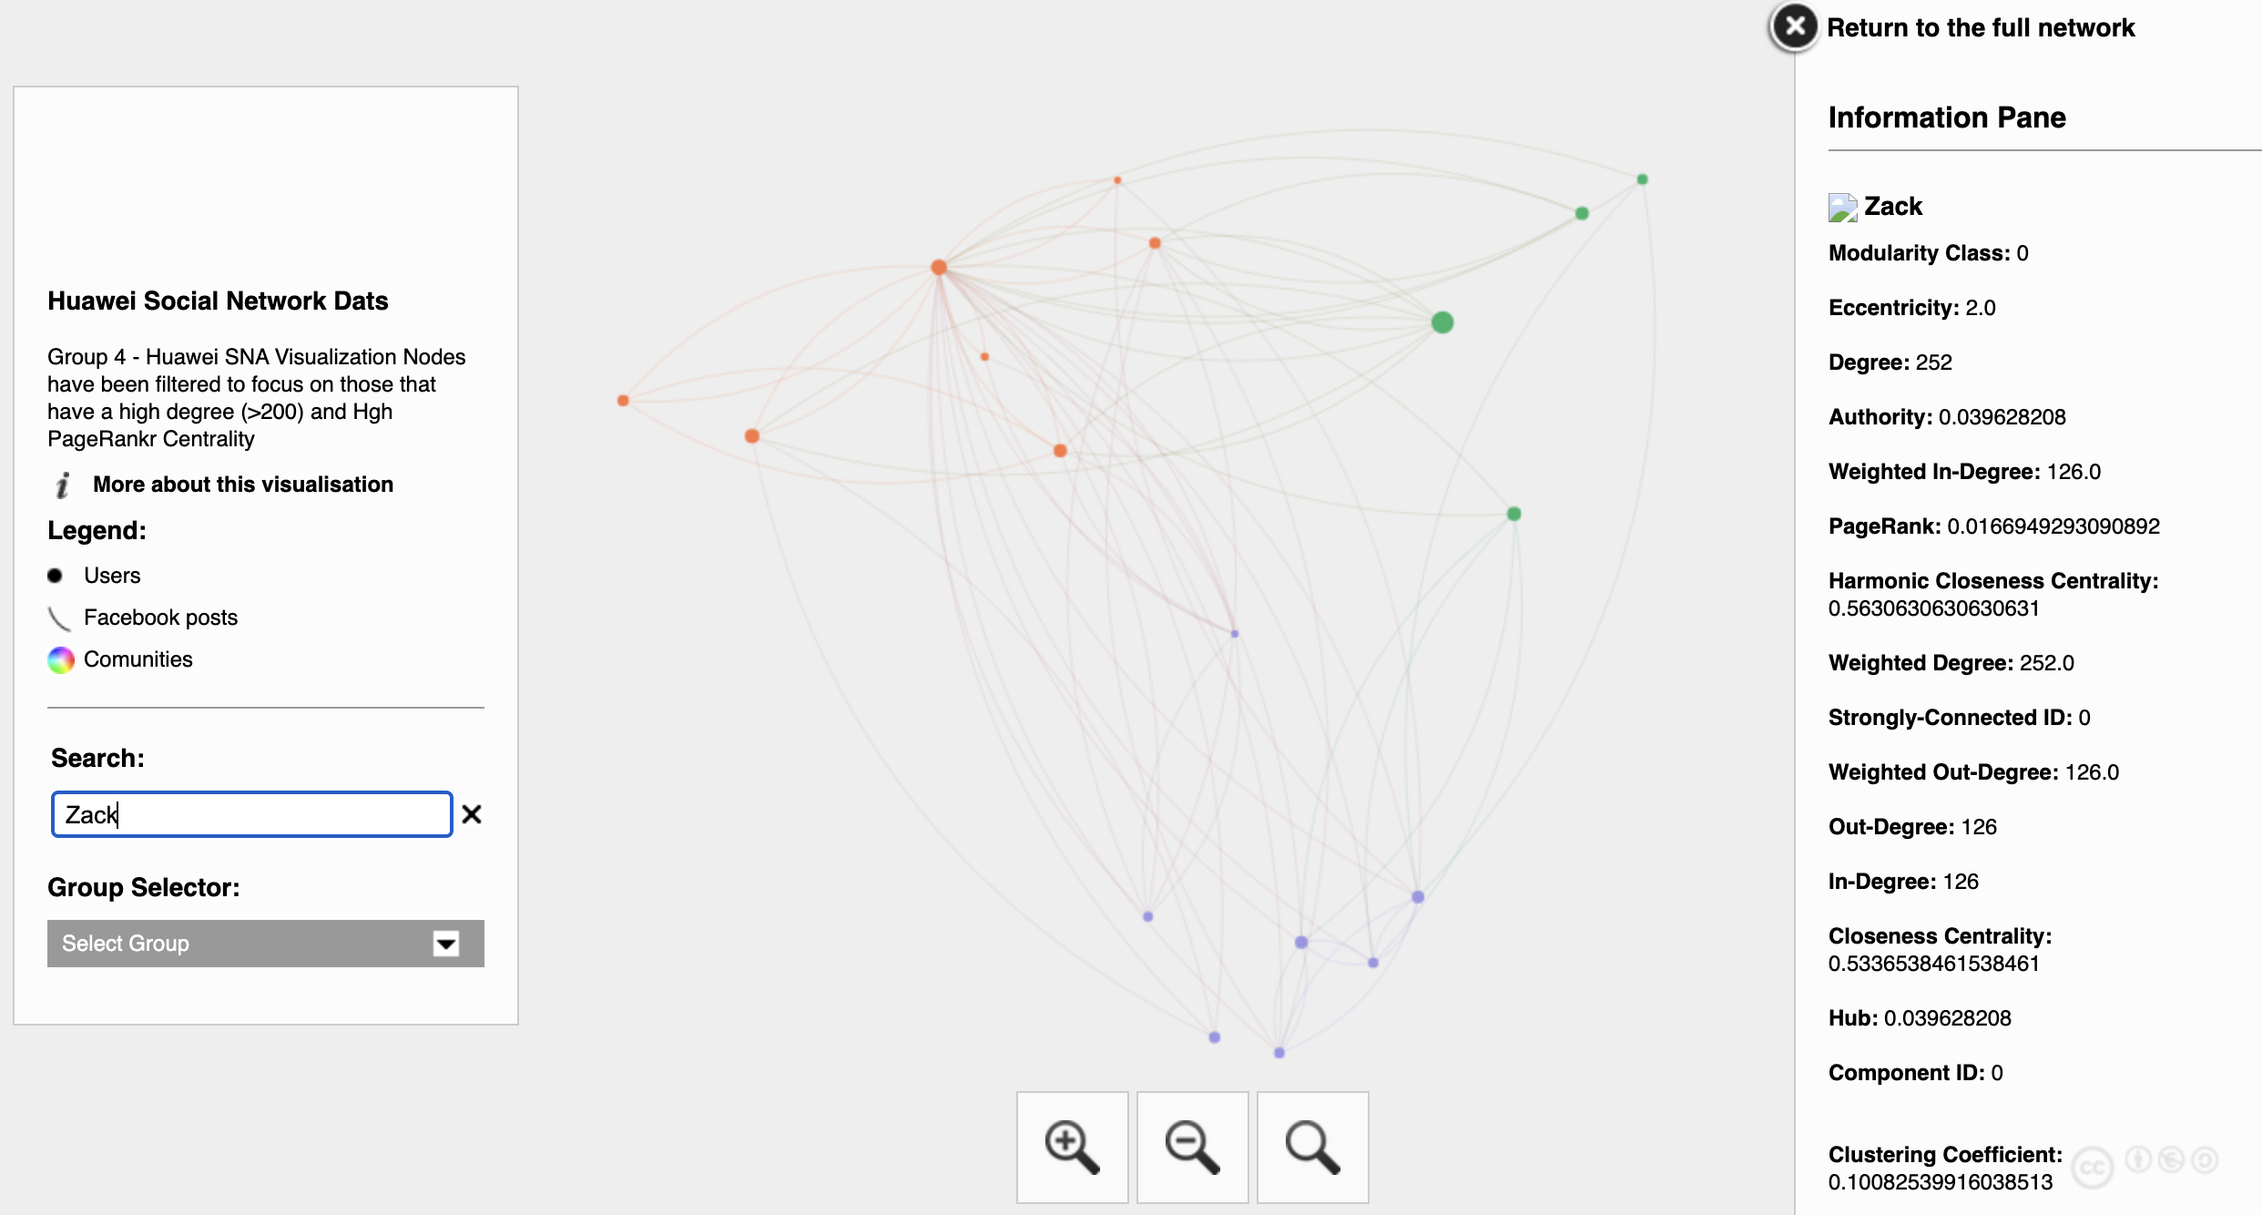
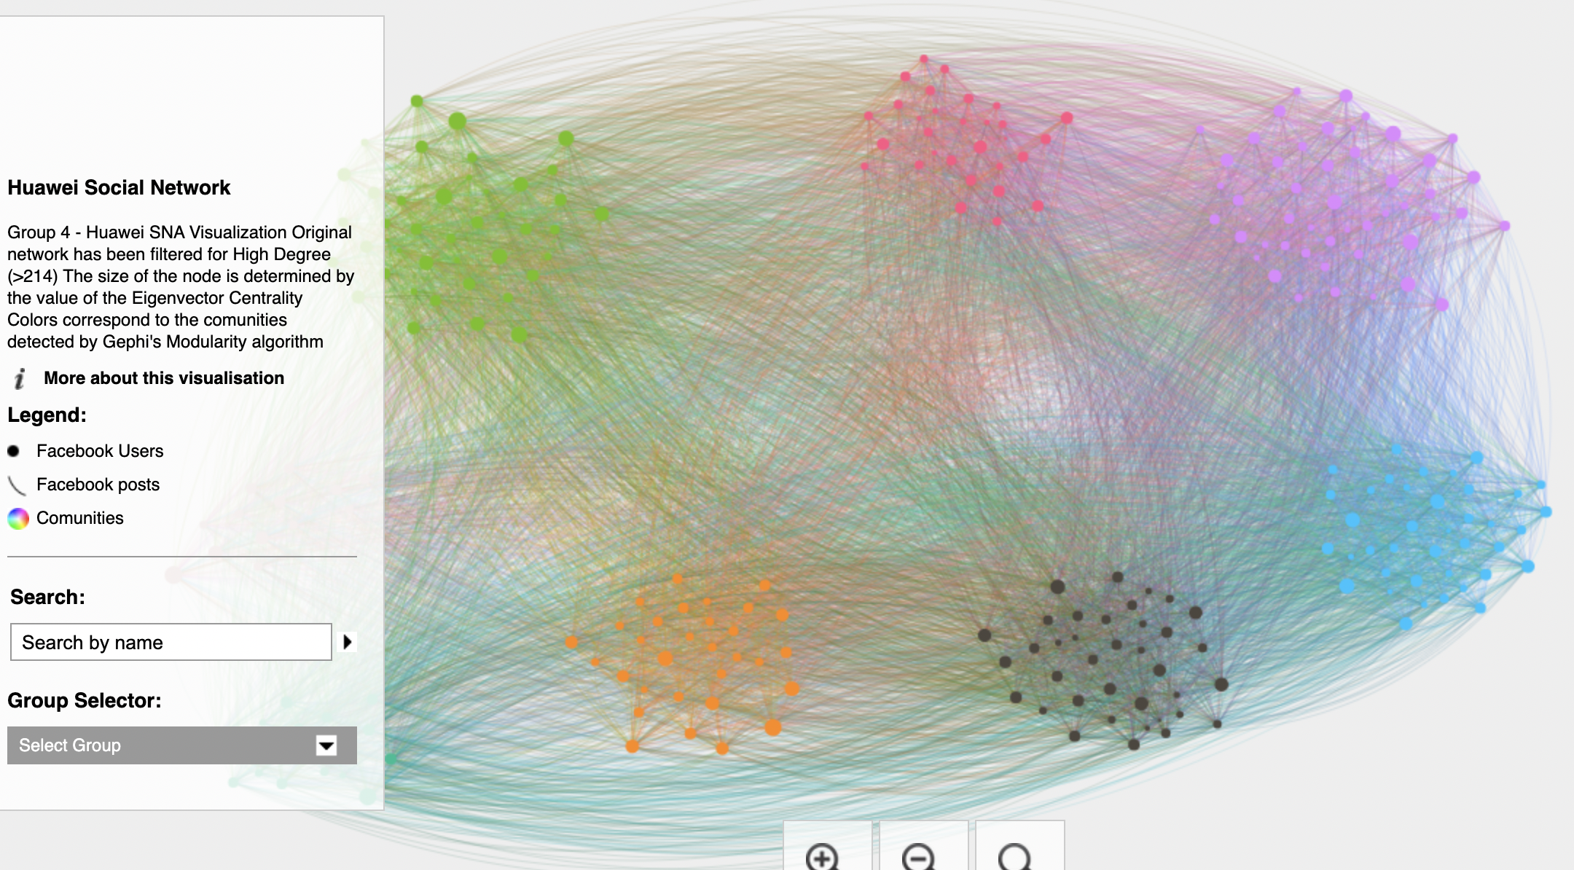
Web App Is Highly Visual And Interactive
EXAMPLE OF THE NETWORK OF A NODE
FULL DATASET
TOP 25% DATASET
Notes:
Mario

Slide 11
Conclusion and Next Steps
CONCLUSION
Betweenness Centrality and Eigenvector Centrality scatterplot is a good start in identifying top potential influencers
Heatmap showed a high correlation between metrics and helped validate our methodology, it’s important add in more metrics to further refine and identify key influencers.
The WordClouds shows some top potential influencers for Huawei to consider in their marketing tactics and can be used to guide the navigation in the web app.
The web app can be used by Huawei marketing department and other areas to explore other potential influencers using the available filters.
NEXT STEPS
Further examination of the metrics would be useful to understand any potential correlations and dependencies.
Further study on the individual networks to explore the relationships and if there are any additional insights or patterns that can be understood.
Notes:
Maggie

